Slide 1
ChatBridge
JAVA CHAT APPLICATION USING GUI
Md Mostafizur Rahman(001134460),Abdullah Maher Kazi(001168253), Syed Dhihan(001162824),Nusrat Hassan Choudhury(001191972)
Group NO-61

Slide 2

Four Important Part of THIS Project:
Coordinator
Most interesting design pattern
Most useful component
Most challenging JUnit test

Slide 3

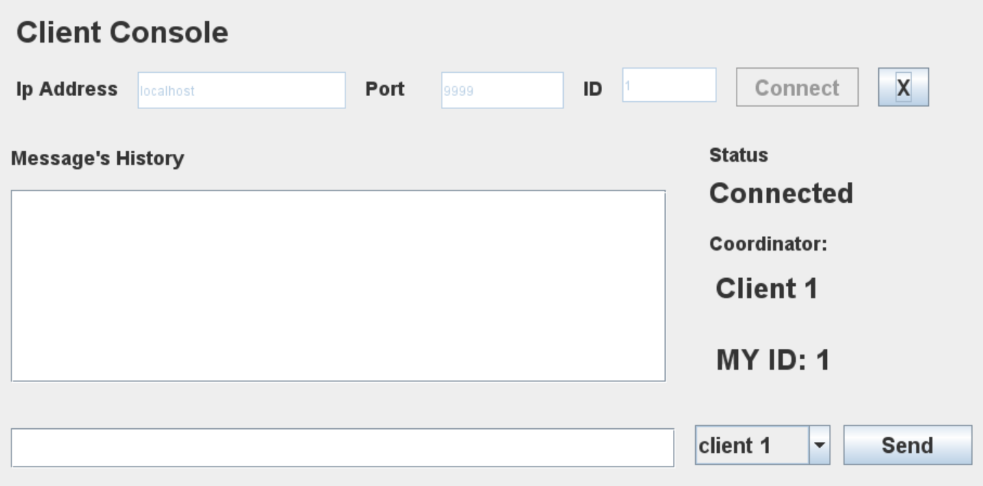
Coordinator:
Coordinator is implemented using a queue in which who ever comes first will serve as coordinator until it does not leave the chat. If coordinator leaves then the oldest client in term of time joined will be the new coordinator.
Example: If Client 1 , Client 2 and Client 3 joins then coordinator will be Client 1.
If Client 1 leaves the chat then Client 2 becomes the coordinator and if client 2 leaves then its Client 3’s turn to become the coordinator.

Slide 4
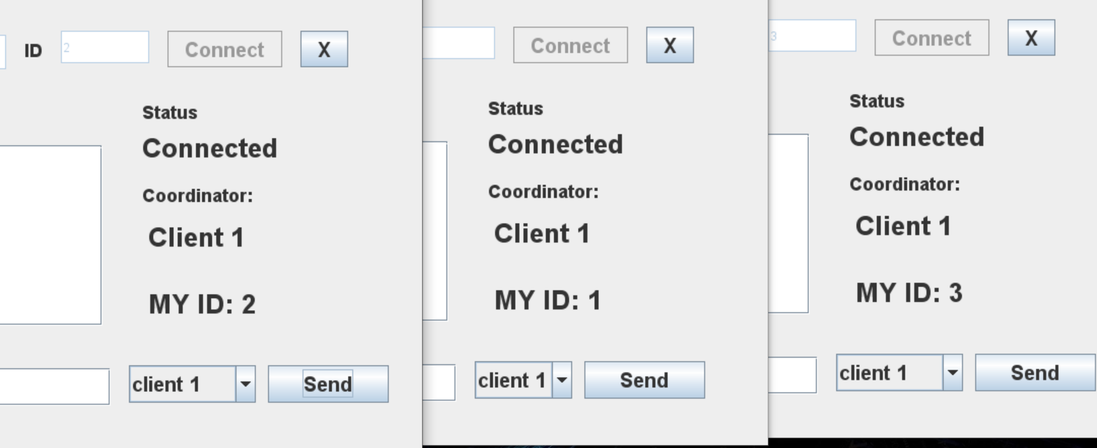
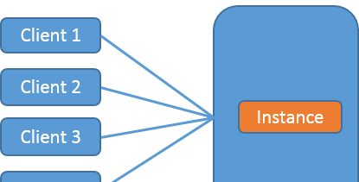
Design Pattern:
Singleton design pattern is used on server side which allows only one instance of server running at a particular time.
Singleton Design Pattern is basically limiting our class so that whoever is using that class can only create 1 instance from that class.
More about singelton design pattern can be found here https://en.wikipedia.org/wiki/Singleton_pattern

Slide 5
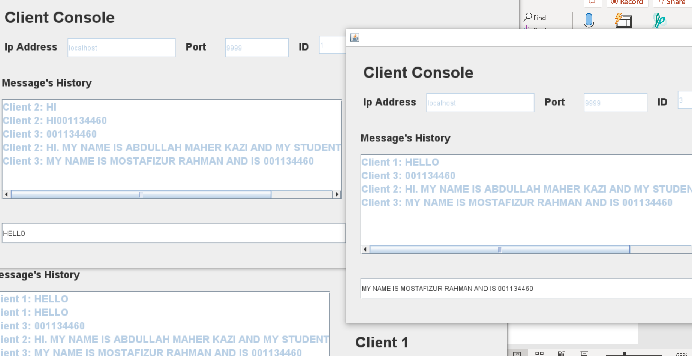
Unique feature:
On Server side there is a thread running at all times whose task is to listen at every time. It basically listens whatever the clients send. It then passes that message to a decision function which will decide what to do next.
The received message contains the control information and the contents of the message too. So, it will un-wrap the message and do accordingly. The message can be of following types:
Client leaves information.
Broadcast message from a client
Private message from a client for another client
Update about a new client who has requested connection with an ID.

Slide 6

JUNIT Testing:
The application has two parts: Client and the server so there are two separate test scenarios for both.
Tests conducted to test the functionality of Server are:
Test broadcast update.
  In this test it is verified that any update regarding a client leave or coordinator changed is received by each client.
Test remove not responding client: If a client left then it sends some formatted message to the server. This test case verifies that it is removed form the client active members list.
Test Update Coordinator: If a client left then each client who are active must know about it . So, this test case is basically focouse this feature.
Send message to: This is as the name suggest it verifies that a message sent to a client is actually received.
Test Broadcast message: This test case verifies the broadcast message, and checks that every active client gets the message that was broadcasted.
Test singleton Pattern: This test the working of singleton pattern
Client-side test conducted:
Test about the invalid input in port and id text field. It will basically check for the whether the value entered against port and id are numeric.
Another test is conducted about the success of the connection establishment with the server.
Testing the Id. When a client joins the chat then it is asked for an id. Which is verified by server and server removes the id clash. So, it is tested by this test that it is successfully assigned.

